Slide 1
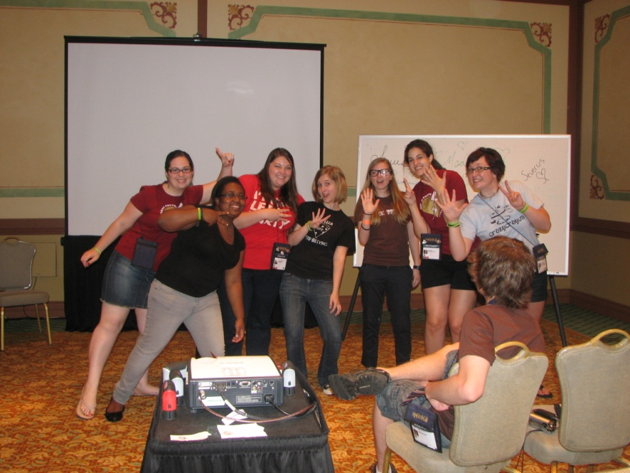
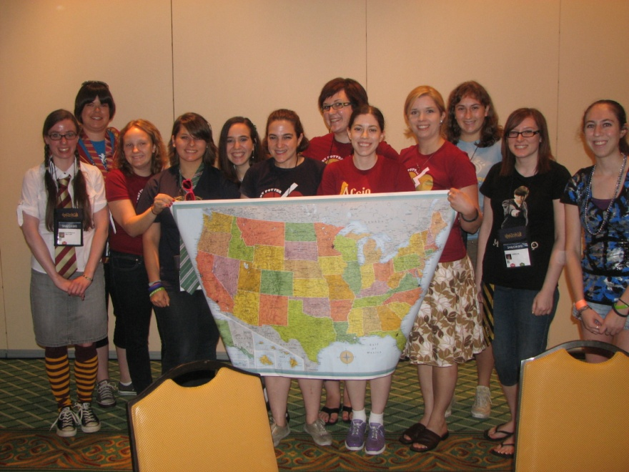
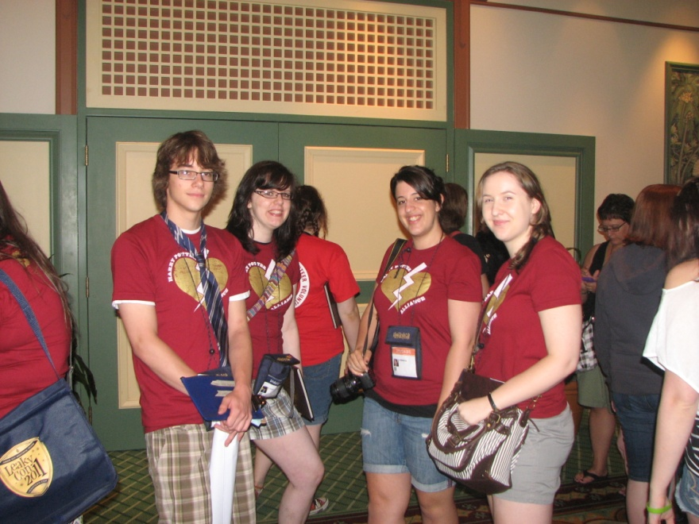
Hpa at leakycon
Notes:
Big amount of staff members – took a lot of the workload of leaky staff but did not get the same amount of recognition
Points a bit to the tension between the fandom and the org

